Slide 1
ASP.NET Core API

Slide 2
AGENDA
The Big Picture
Approaches
The pipeline and middleware

Slide 3
ASP.NET Core
A cross-platform, high-performance, open-source framework for building
modern, cloud-enabled, internet-connected apps

Slide 4
ASP.NET Core: The Big Picture
Build web apps and services, IoT apps and mobile backends
Develop on Windows, Linux and macOS
Deploy to the cloud or on-premises
Run on .NET (or .NET Core, depending on the version)

Slide 5
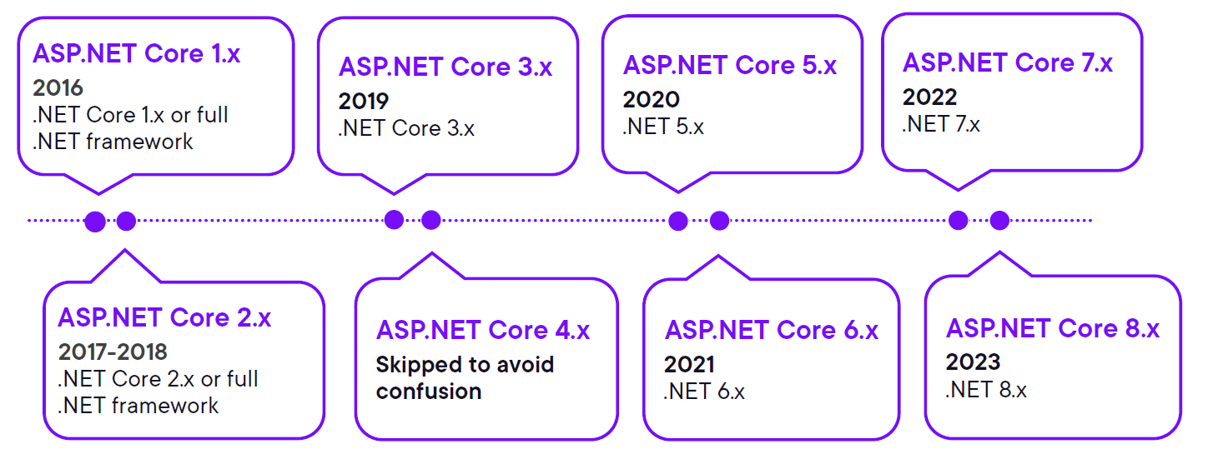
ASP.NET Core History

Slide 6


ASP.NET Core History
Full .NET framework (4.8)
No new development
.NET Core vNext (“4.x”)
Useful functionality from the full .NET
framework ported to increase performance
and support cross-platform development

Slide 7


Approaches to Building APIs with ASP.NET Core
ASP.NET Core Minimal API
ASP.NET Core MVC

Slide 8
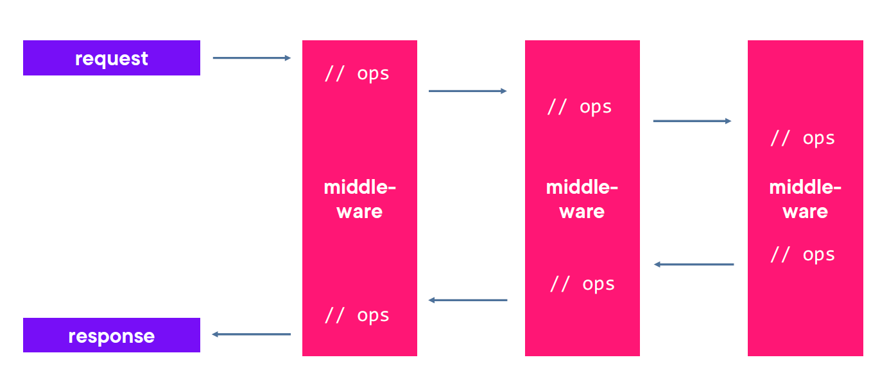
The ASP.NET Core Request Pipeline & Middleware
Middleware
Software components that are assembles into an application pipeline to
handle requests and responses

Slide 9
AGENDA
Clarifying the MVC pattern
Status codes
Problem details
Content negotiation

Slide 10
Clarifying the MVC Pattern
Very common pattern
- Exists in many languages, supported by
many frameworks
- Used to build client-facing ASP.NET Core
web applications
Improves separation of concerns
Improves testability
Promotes reuse

Slide 11
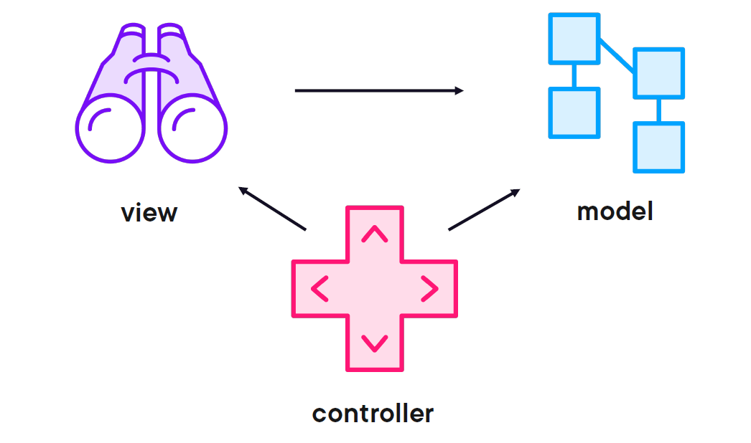
Clarifying the MVC Pattern
Model
Application data and/or business logic & rules View
Representation of model data
Controller
Enables accepting user input and translating that to model data the view
can work with

Slide 12
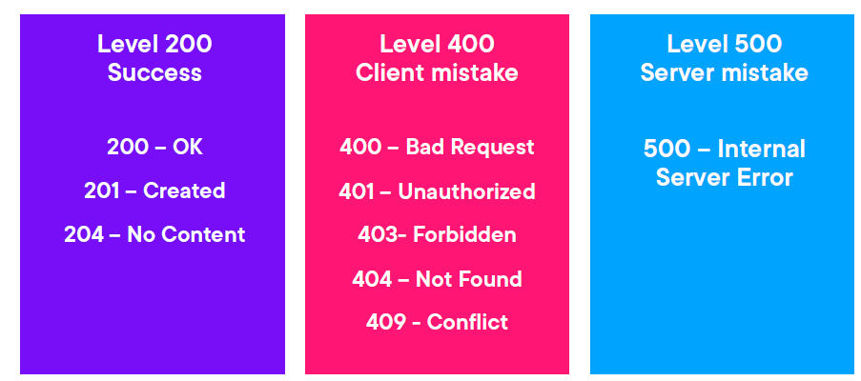
The Importance of Status Codes

Slide 13
